Slide 1
The Economics of Pandemics
Rajiv Sethi and the CORE Team

Slide 2
Data Sources
Historical/International Data: Our World in Data (OWiD)
Macroeconomic Data for the US: Federal Reserve Economic Data (FRED)
Financial Market Data: Google Finance

Slide 3
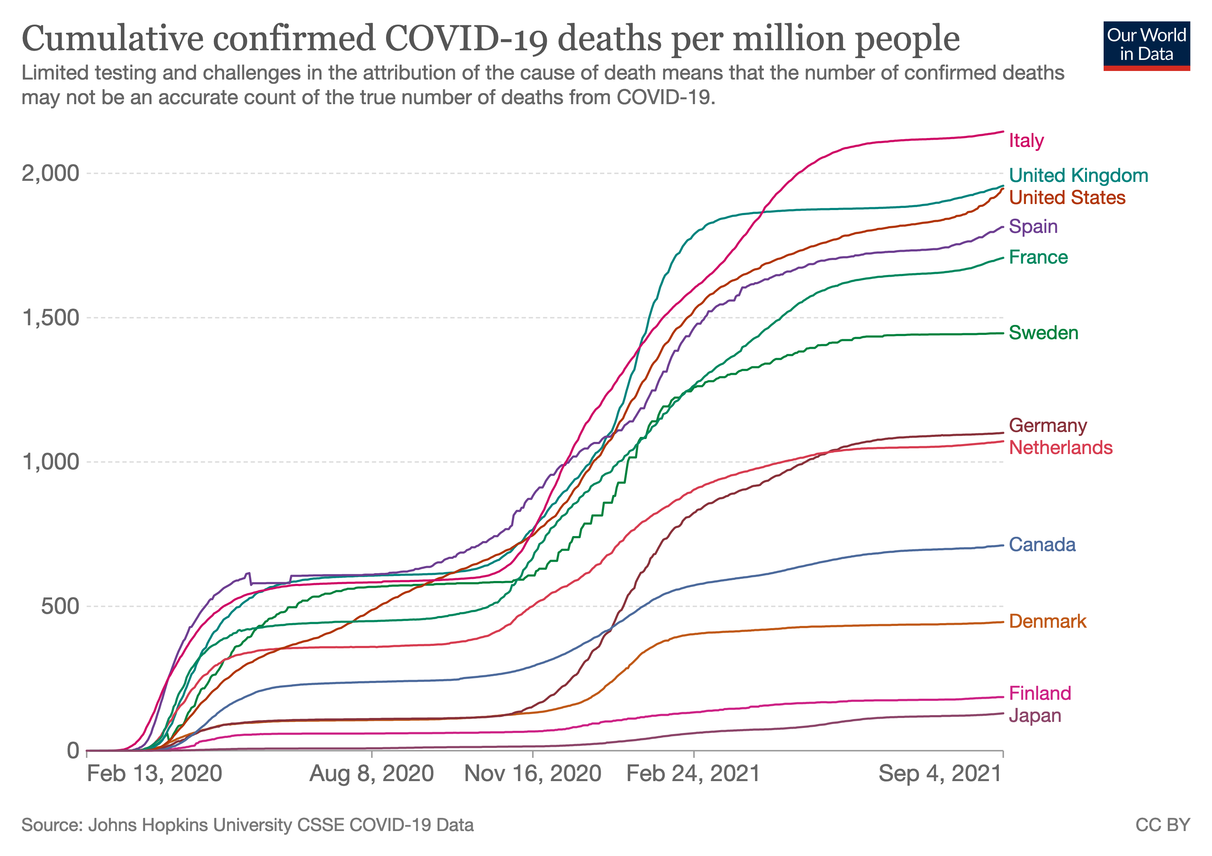
View Latest Data

Slide 4
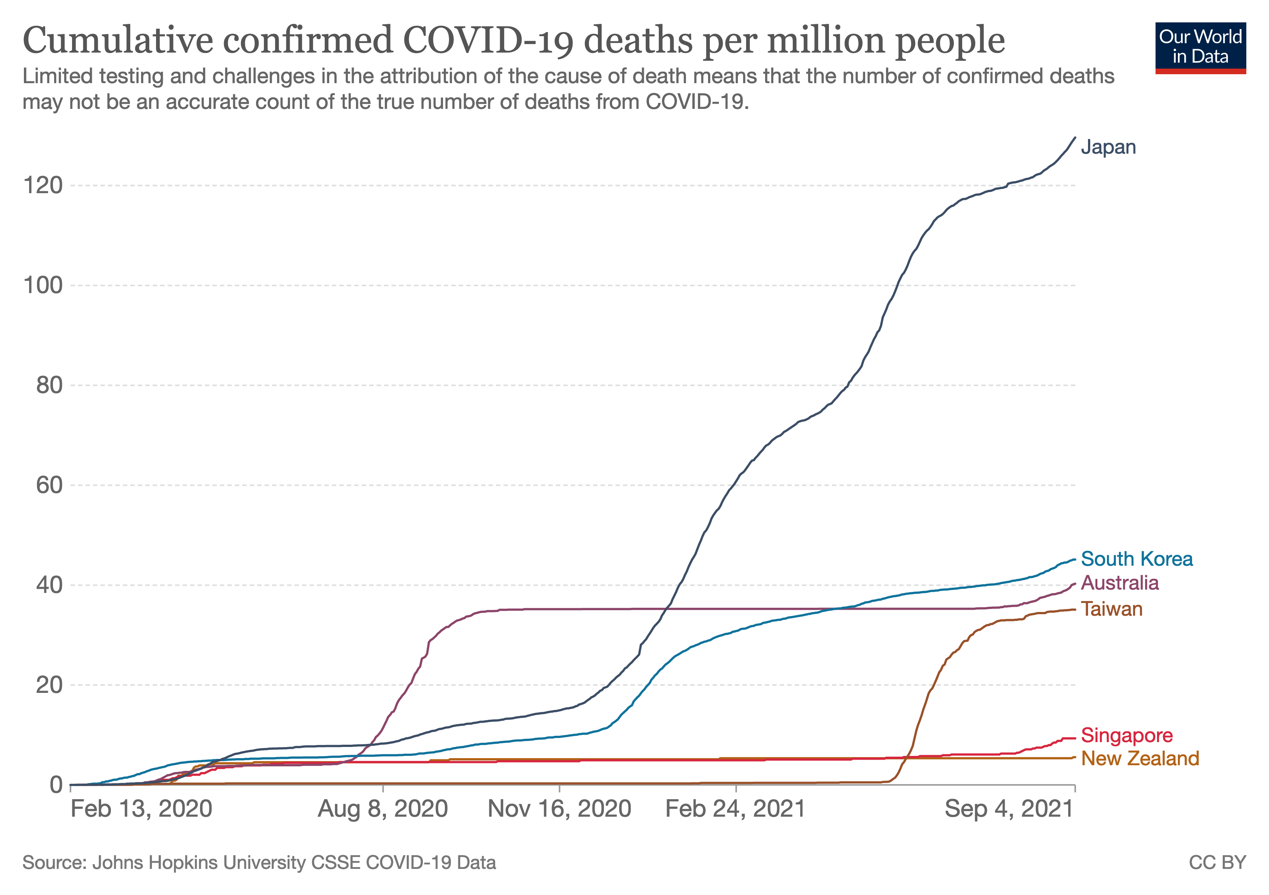
View Latest Data

Slide 5
Data Issues
Data on deaths doesn’t account for variation in testing/attribution
High growth can arise from greater testing or spread of virus
Differences across countries can also arise from reliability of reporting
Still, cross-country comparisons can be informative

Slide 6

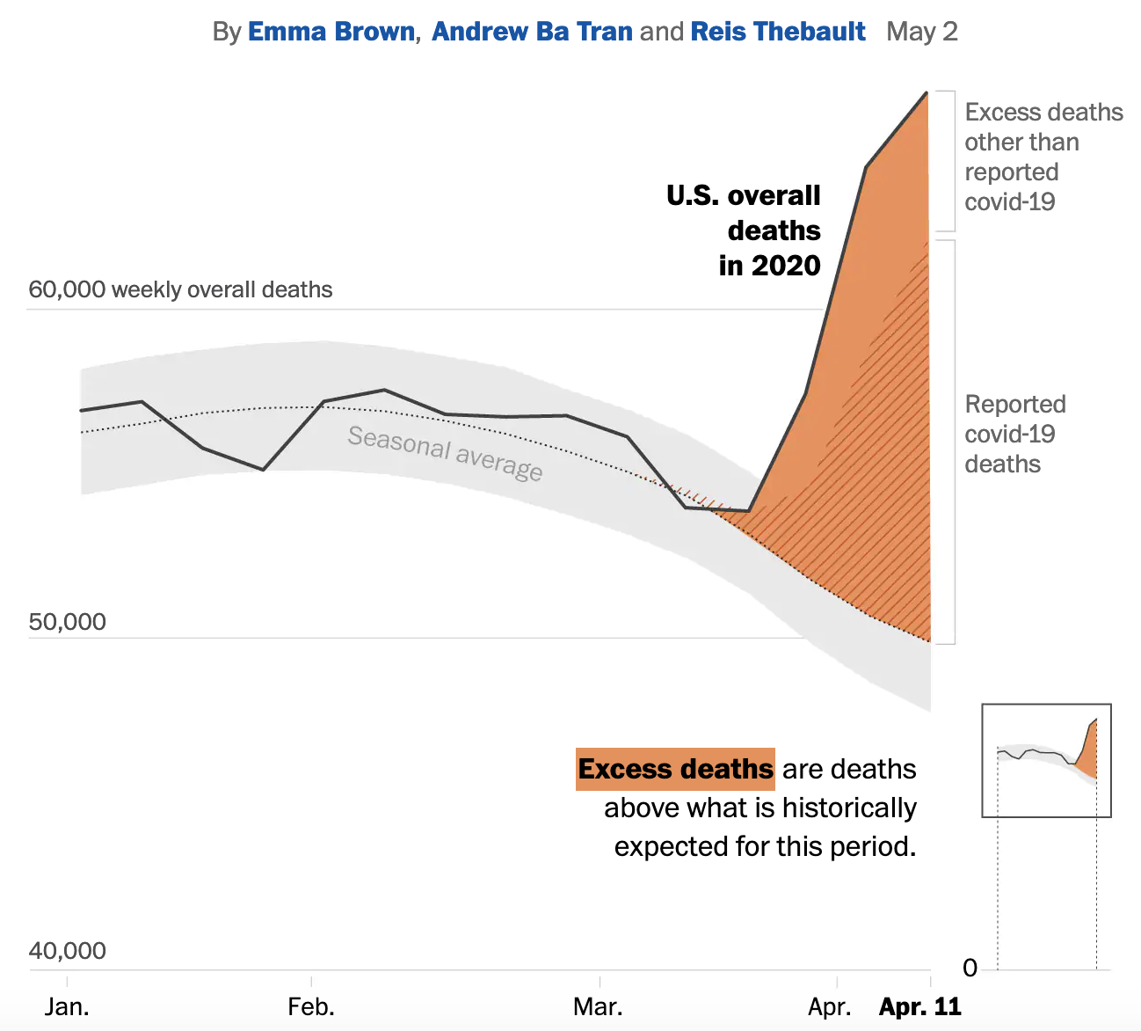

Slide 7

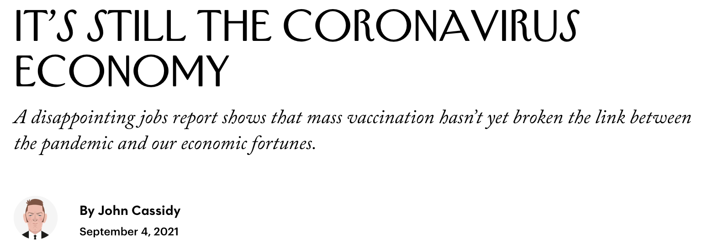

Slide 8
Composition and Scale
Economic effects of COVID-19 can be partitioned into two categories
Composition effects refer to collapse in demand for some goods/services
Even as there is surging demand for others
Collapsing demand: travel, lodging, meals, entertainment, durables
Surging demand: health services, masks, ventilators, sanitizers, software
Scale effects refer to the collapse in aggregate output and employment
Notes:
Relevant section of The Economy:
How changes in demand for goods and services affect unemployment The Economy (Unit 9.7): https://core-econ.org/the-economy/book/text/09.html#97-how-changes-in-demand-for-goods-and-services-affect-unemployment
Great Depression The Economy (Unit 17.2) https://core-econ.org/the-economy/book/text/17.html#172-the-great-depression-positive-feedbacks-and-aggregate-demand

Slide 9
Asset Prices
Prices of shares reflect expectations of future profitability
Demand contraction lowers expected profits and stock prices
Somewhat mitigated by wage effects of higher unemployment
So stock market indexes (Dow Jones, S&P 500) fall
Stocks of airline, cruise lines fall especially far
But some assets rise in price: Zoom Video Communications (ZM)
Notes:
Relevant section in The Economy: Asset prices (The Economy 11.5): https://core-econ.org/the-economy/book/text/11.html#115-the-value-of-an-asset-basics
Relevant section in ESPP: Unit 10.8: https://www.core-econ.org/espp/book/text/10.html#108-the-value-of-an-asset-expected-return-and-risk

Slide 10
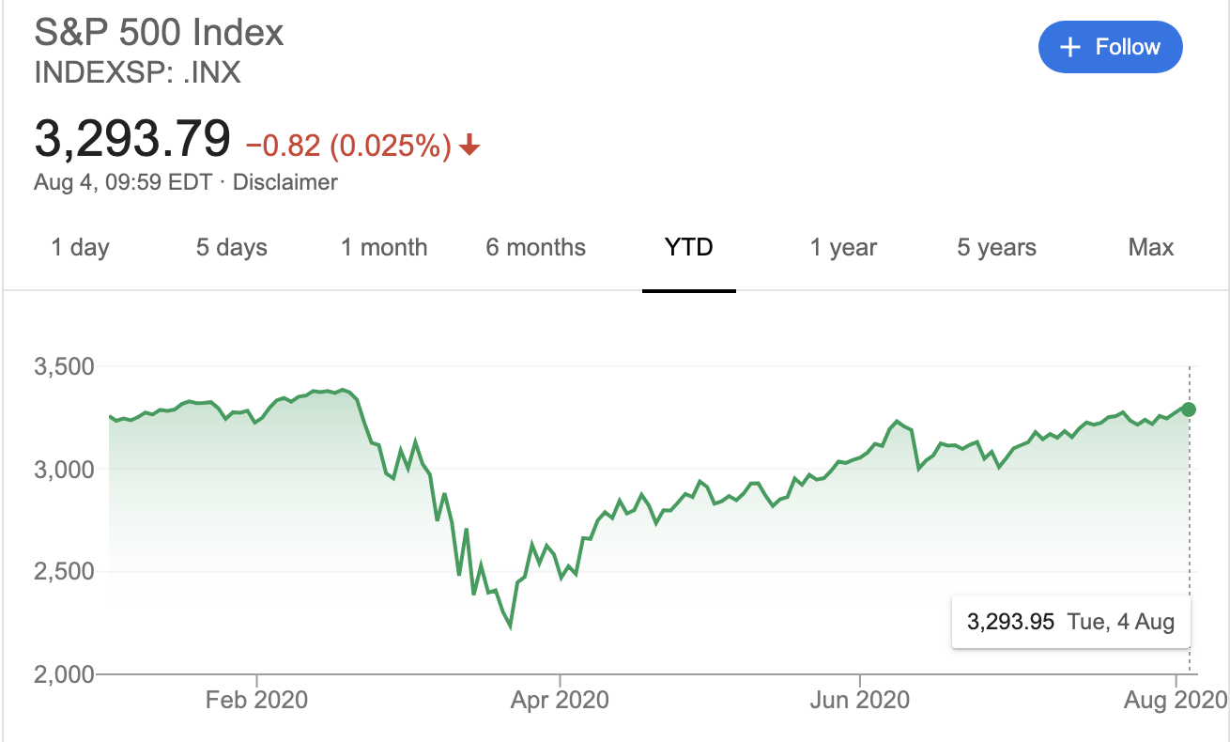
View Latest Data

Slide 11
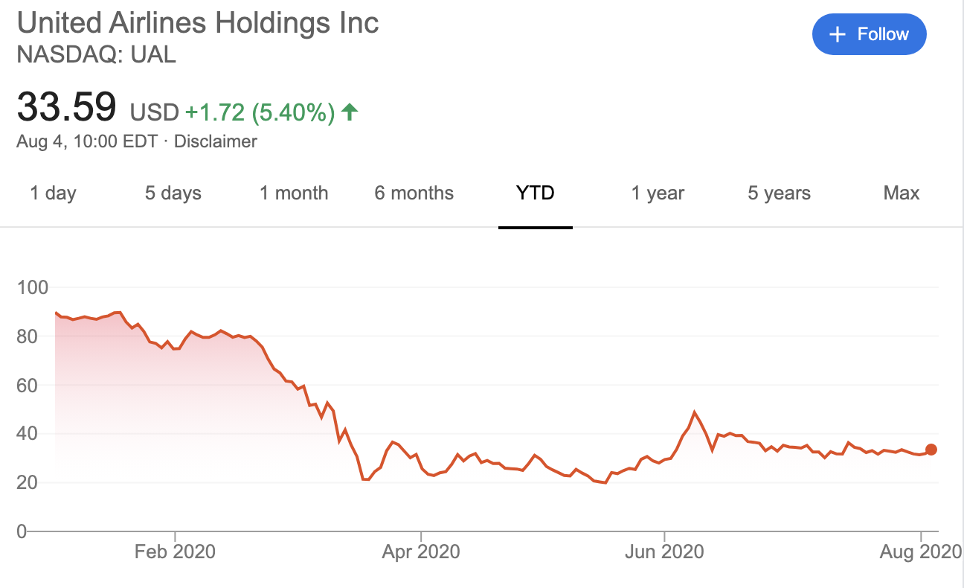
View Latest Data

Slide 12
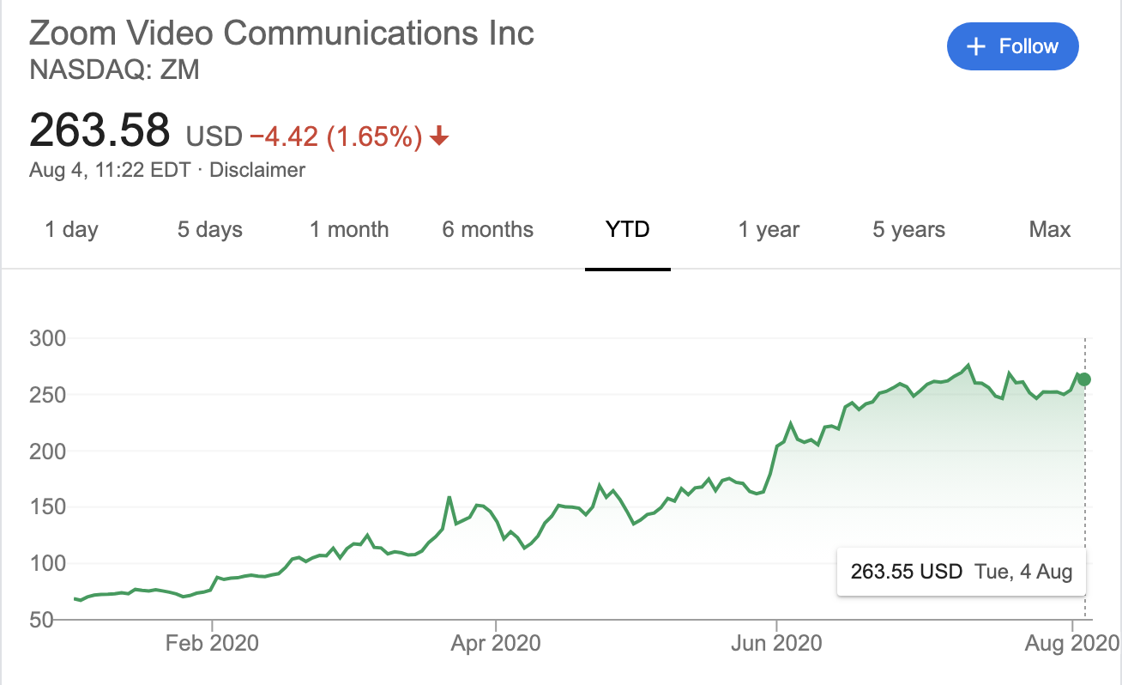
View Latest Data

Slide 13
Scale Effects
Output in last quarter of 2019 was $21.7 trillion (GDP, annualized)
Second quarter of 2020 it was 19.5 trillion (see latest data)
Unemployment rate was 3.5% in Feb 2020, rose to 14.8% in April
By August 2021, had fallen to 5.2% (see latest data)
Notes:
Relevant section of The Economy:
How changes in demand for goods and services affect unemployment The Economy (Unit 9.7): https://core-econ.org/the-economy/book/text/09.html#97-how-changes-in-demand-for-goods-and-services-affect-unemployment
Great Depression The Economy (Unit 17.2) https://core-econ.org/the-economy/book/text/17.html#172-the-great-depression-positive-feedbacks-and-aggregate-demand

Slide 14

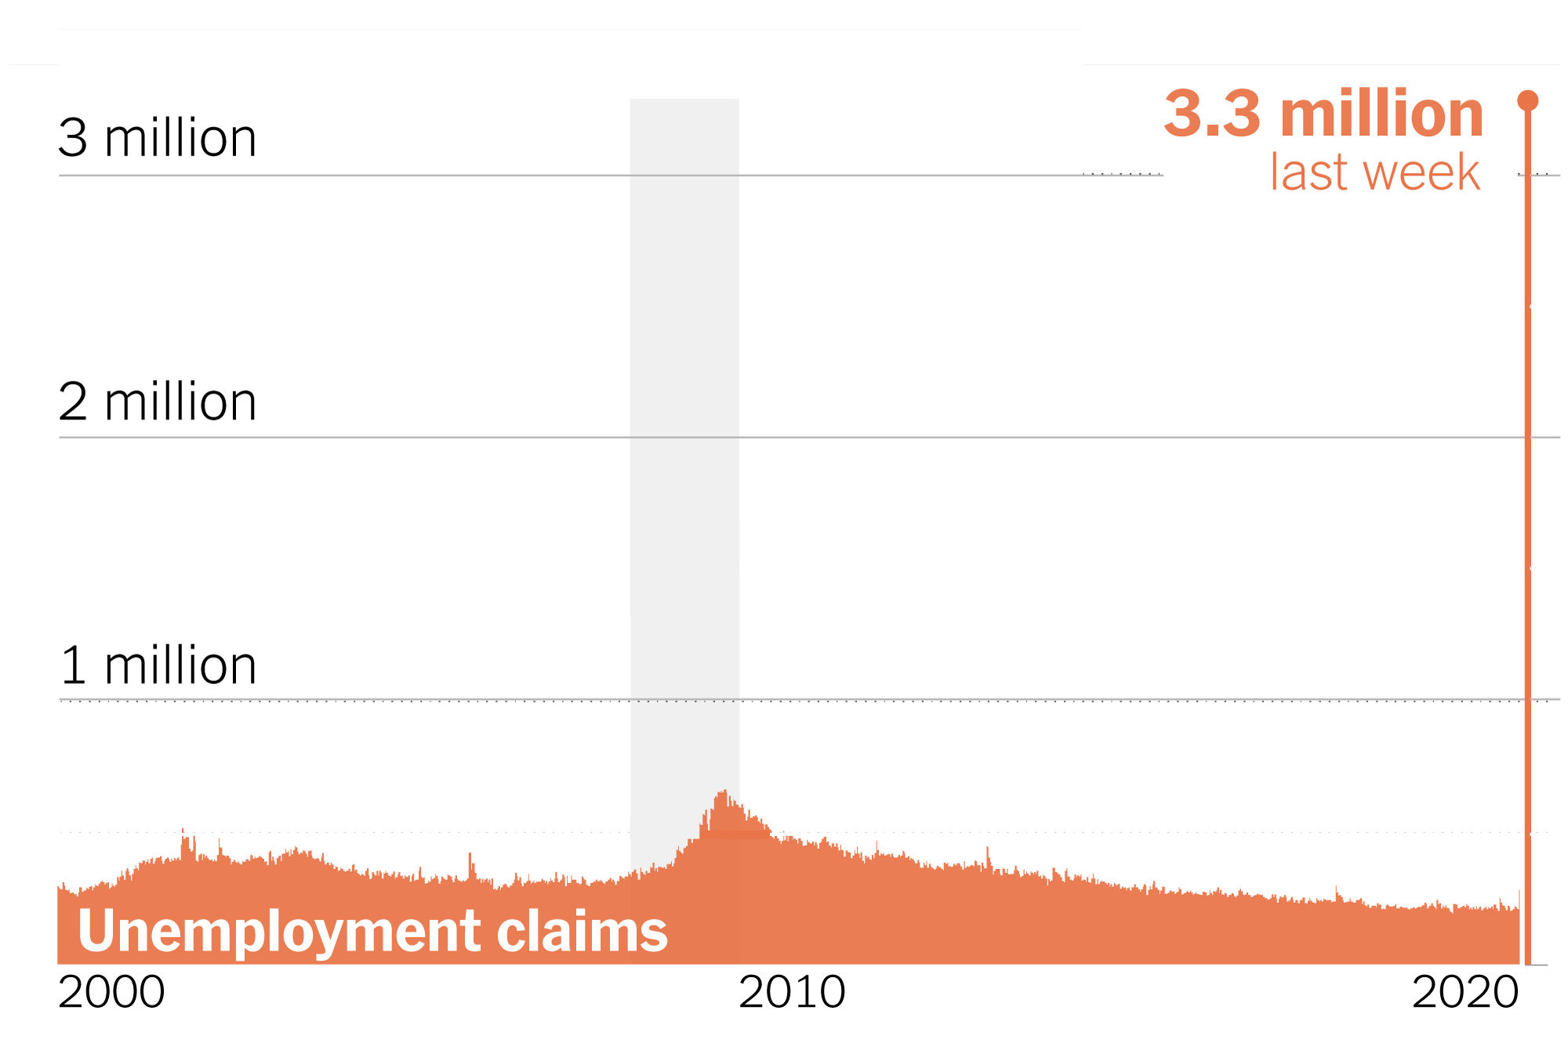

Slide 15
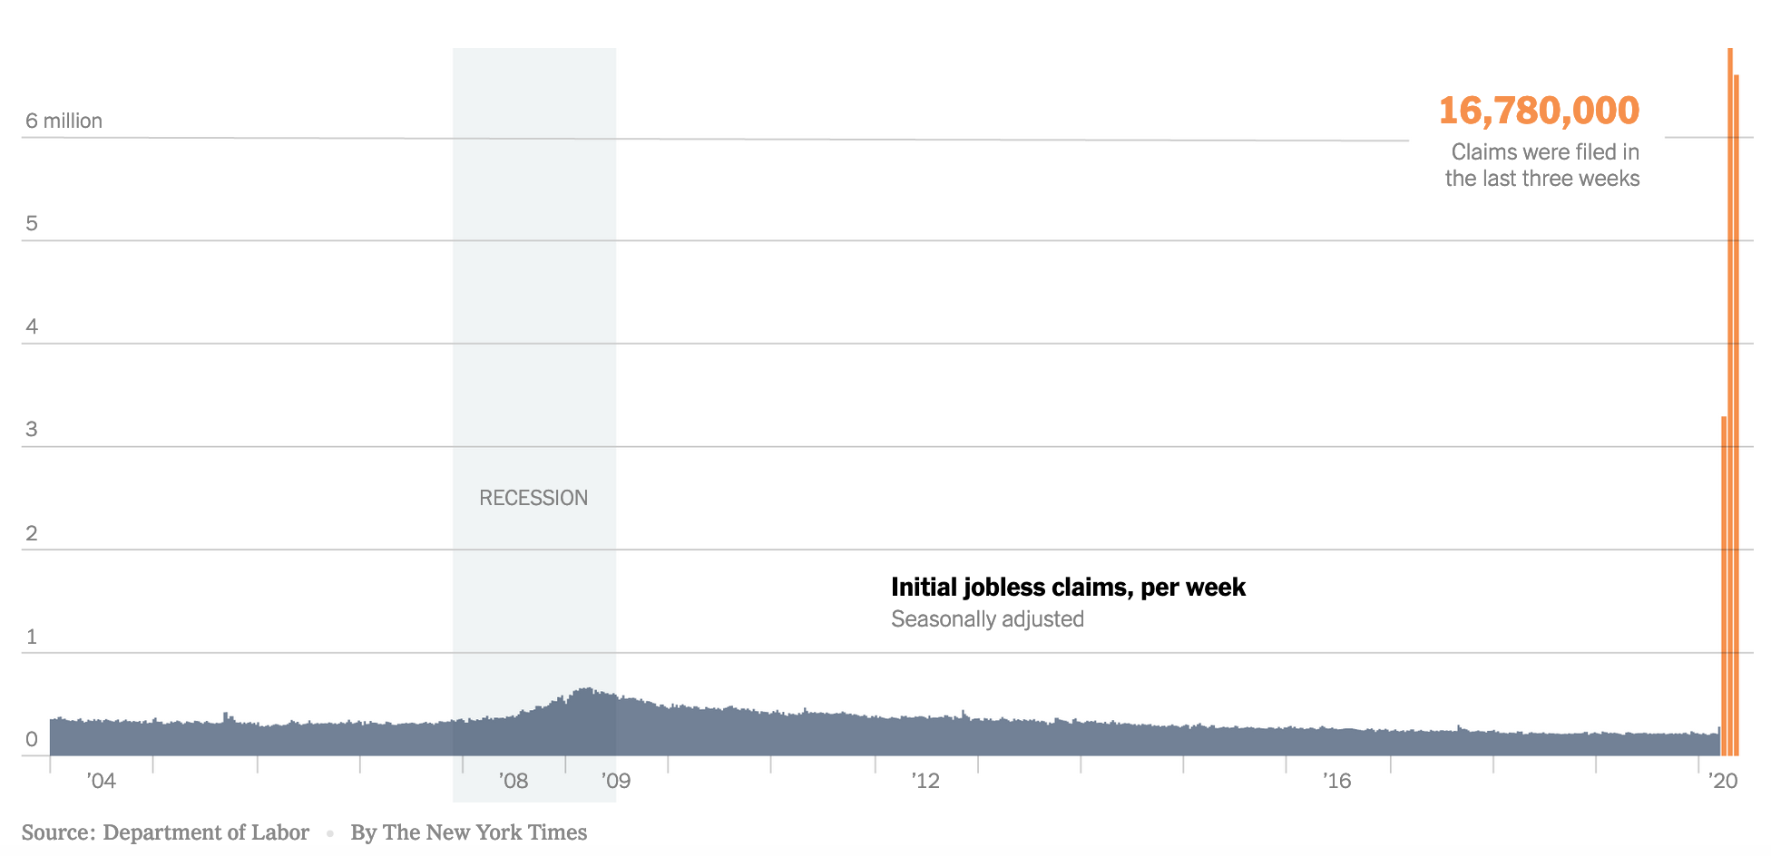

Slide 16
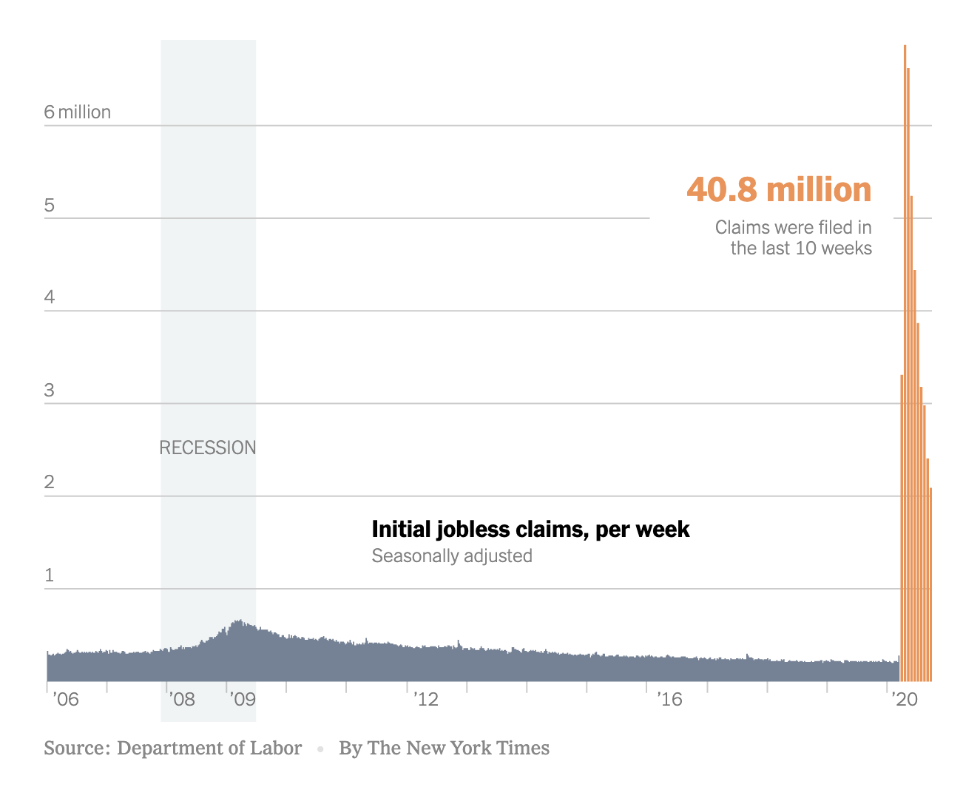
View Latest Data

Slide 17
Multiplier Effects and Policy Responses
As layoffs and bankruptcies rise, aggregate demand falls further
Multiplier effect amplifies decline, lead to recession
Mitigated by automatic stabilizers: lower taxes, higher expenditure
Policy response: Expansionary fiscal and monetary policy
Federal Reserve: lower interest rates, asset purchases
Treasury: tax cuts, delayed filing, increased benefits, cash payments
Other policies: suspension of loan repayments and evictions
Notes:
Relevant sections in The Economy:
Multiplier effect (The Economy Unit 14.1): https://core-econ.org/the-economy/book/text/14.html#141-the-transmission-of-shocks-the-multiplier-process
Fiscal policy (The Economy Unit 14): https://core-econ.org/the-economy/book/text/14.html
Monetary policy (The Economy Unit 15): https://core-econ.org/the-economy/book/text/15.html
Historical comparisons with Great Depression and global financial crisis (The Economy Unit 17): https://core-econ.org/the-economy/book/text/17.html

Slide 18
Policy Responses in the United States
Fiscal Policy (Congress)
Coronavirus Aid, Relief, and Economic Security (CARES) Act
Direct Payments to Households
Expanded unemployment insurance eligibility and benefits
Paycheck Protection Program (forgivable loans to businesses)
Monetary Policy (Federal Reserve Bank)
Interest rate cuts
Main Street Lending Program
Municipal Liquidity Facility

Slide 19
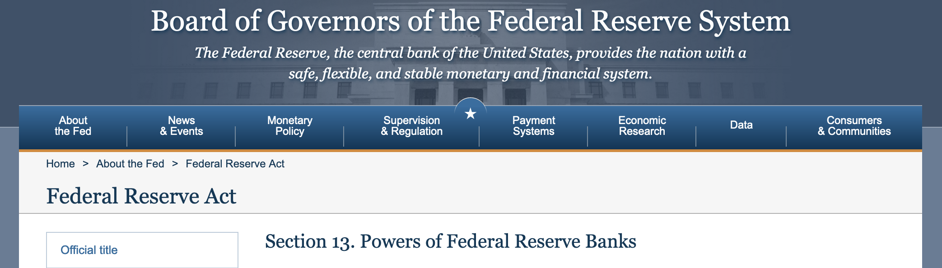
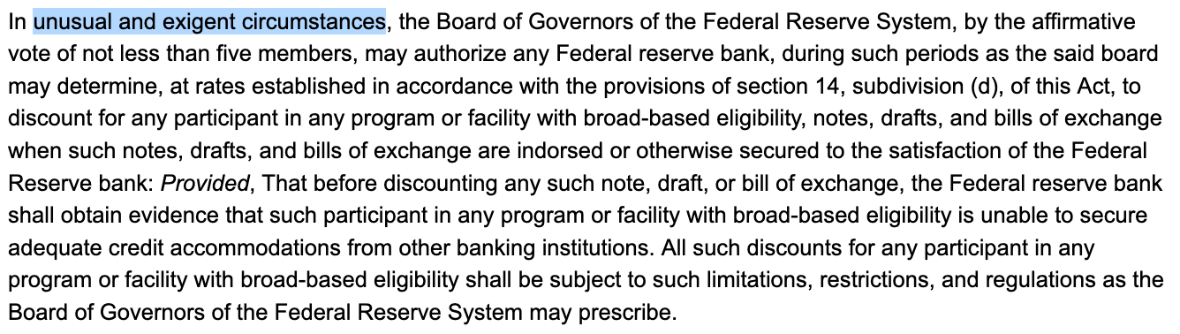

Slide 20
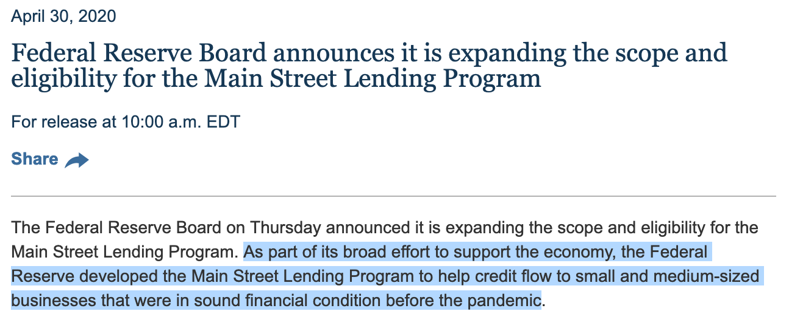

Slide 21
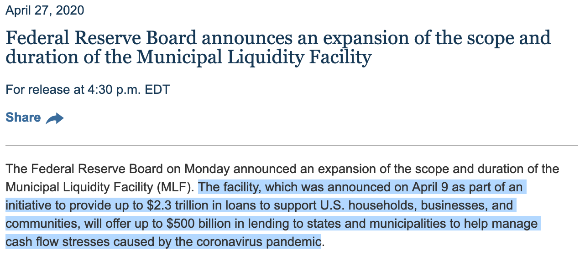

Slide 22
External Effects
Distancing, quarantine, masks, vaccination have costs and benefits
Costs are mostly private while benefits are also social
If people only equate private benefits and costs, insufficient protection
Policy: closings, cancellations, mobility restriction, free testing and vaccine
Vaccine development also not profitable (before or after pandemic)
Policy response: subsidies and grants for vaccine development
Notes:
Relevant sections in The Economy:
Discussion of public goods in The Economy: https://core-econ.org/the-economy/book/text/04.html#46-public-goods-free-riding-and-repeated-interaction
External effects in The Economy (Unit 12): https://core-econ.org/the-economy/book/text/12.html
Vaccine development - link to innovation and patents (The Economy, Unit 21): https://core-econ.org/the-economy/book/text/21.html
Government as an economic actor: The Economy (Unit 22) https://core-econ.org/the-economy/book/text/22.html#221-the-government-as-an-economic-actor
Relevant sections in Economy, Society, and Public Policy:
Discussion of public goods in ESPP: https://www.core-econ.org/espp/book/text/02.html#27-free-riding-and-the-provision-of-public-goods
External effects in ESPP (Unit 11.7): https://www.core-econ.org/espp/book/text/11.html#117-market-failure-external-effects-of-pollution
Government as an economic actor: ESPP (Unit 12) https://www.core-econ.org/espp/book/text/12.html#123-the-government-as-an-economic-actor

Slide 23
Social Preferences
Those with exposure or symptoms should self-quarantine
But this also has private costs and social benefits
In fact private benefits are few (too late to prevent infection)
Benefits may even be negative: loss of wages
So why do many people self-quarantine?
Social preferences: concern for others and civic responsibility
Policy response: acknowledge and encourage civic responsibility
But not all are responsive to such initiatives, or can afford to stay home
Policy response: screening and isolation, paid sick leave
Notes:
Relevant sections in The Economy:
Social preferences (The Economy Unit 4.4): https://core-econ.org/the-economy/book/text/04.html#44-social-preferences-altruism
Relevant sections in ESPP:
Social preferences (ESPP Unit 2.10): https://www.core-econ.org/espp/book/text/02.html#210-how-three-kinds-of-social-preferences-address-social-dilemmas

Slide 24
This Time is Different
Not an internally generated event but an external threat
Unlike Great Depression and Global Financial Crisis
Fiscal and monetary policy necessary but not sufficient
External threat needs to be dealt with swiftly and decisively at source
Alternative is waves of lockdown and relaxation
Need to reopen and stay open
Need to save lives while saving livelihoods
How can we do this?

Slide 25

